Slide 1

AUTHENTICATION USING FACIAL RECOGNITION

Slide 2

ABSTRACT
Object Detection, powered by computer vision and deep learning techniques such as CNNs, has become increasingly significant in various industries, including security, automobile, and healthcare. CNNs play a vital role in simplifying the process of segmentation and Object Detection, making it easier than ever before to develop Object Detection applications. This report will focus on CNN's workflow architecture, explain how it works, and discuss its various industrial use cases. It will also cover the history of Object Detection, current applications, and conclude with the advantages, disadvantages, and future improvements that can be made to the model.

Slide 3

INTRODUCTION
Machine learning techniques are used for facial detection.
The process includes face detection, alignment, feature extraction, and classification.
Facial detection has a wide range of applications in various fields including security, entertainment, healthcare, and marketing.
Deep learning techniques such as convolutional neural networks have enabled the development of more accurate and robust systems for facial detection.
Facial detection is a rapidly growing field with significant potential for future applications.

Slide 4
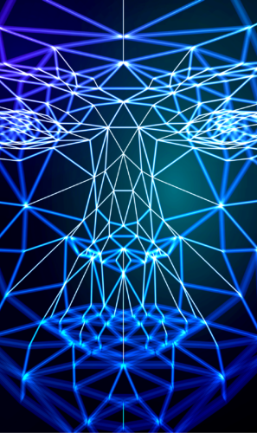
PROBLEM STATEMENT
Traditional attendance tracking systems using biometric sensors have limitations including hygiene concerns, high costs, and slow processing times.
Facial detection has the potential to provide a more convenient, hygienic, and cost-effective solution for attendance tracking.
Facial detection is particularly relevant in the era of remote work and online learning.
Implementing facial detection for attendance tracking requires addressing challenges including accurate and efficient face detection and recognition algorithms, privacy concerns, and system security and reliability.
This project aims to develop a facial detection system for attendance tracking in employee and student settings that can provide a cost-effective and convenient solution while addressing privacy and security concerns.

Slide 5
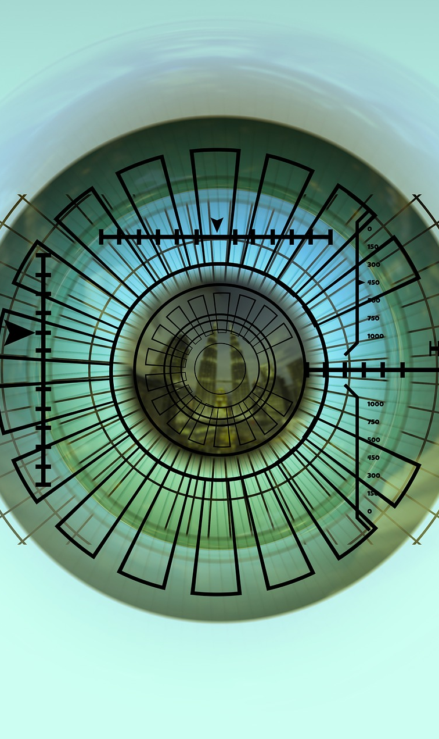
DATASET OVERVIEW
The team has facial images of each team member in '.png' format.
These images are used to train and classify faces using a model that can handle both '.jpg' and '.png' formats.
The team also has a pre-trained Haar cascade classifier file in '.xml' format.
The classifier file is used to detect objects in images or videos.
Training the classifiers can be challenging, and the algorithm's accuracy depends on the quality of the training data.

Slide 6

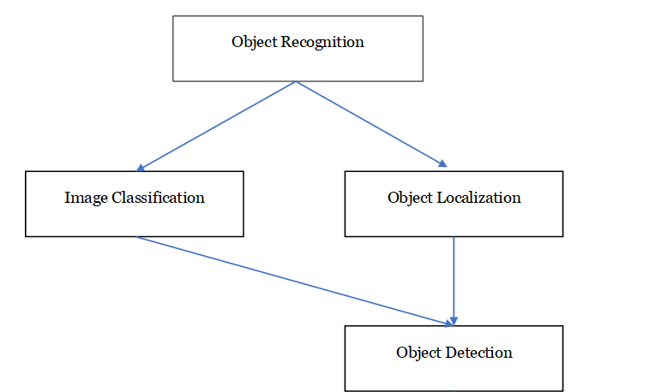
METHODLOGY
Our experiment focuses on using facial recognition to authenticate users and track their attendance through detecting their faces. To achieve this, we focused on two crucial aspects: identifying the Object Localization and Object Classification. We created separate programs for each of these areas and ensured we had a comprehensive understanding of how they worked.

Slide 7
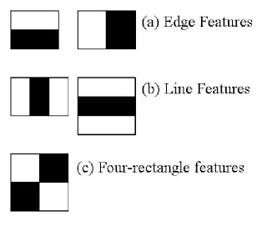
Haar-cascade
Training – Using gradient images divide sed to train a classifier using the Haar feature-based cascade classifier algorithm
Classification –
Edge features: A pair of adjacent rectangles with opposite intensities used to detect edges and one-dimensional features in the image.
Line features: A set of three adjacent rectangles arranged in a line, used to detect linear features such as edges and lines.
Four-rectangular features: Four adjacent rectangles arranged in a square or rectangle, used to detect rectangular patterns such as the corners or edges of objects.

Slide 8



DATASET CREATION
We created a custom dataset that included facial images of all team members. This dataset was used to train our facial recognition model.
Karan
Priyanshu
Raj

Slide 9
DATASET TRAINING
We created a program that would train the facial recognition model on our custom dataset. The output of this program was an in-depth classification for each team member's face and a .yml file containing all the facial feature extractions of the dataset faces.
Dataset
Classification
Localization
Detection
Facial Recognition
Haar.xml
Trainer.yml

Slide 10
GRAPHICAL USER INTERFACE(GUI)
A graphical user interface (GUI) was created to live-detect users' faces and mark attendance.
The GUI is designed to work with data that already exists in the dataset.
However, the model does not incorporate a database to track user attendance.
The GUI is user-friendly and easy to navigate.
The goal was to create a functional and efficient system for attendance tracking through facial recognition.

Slide 11
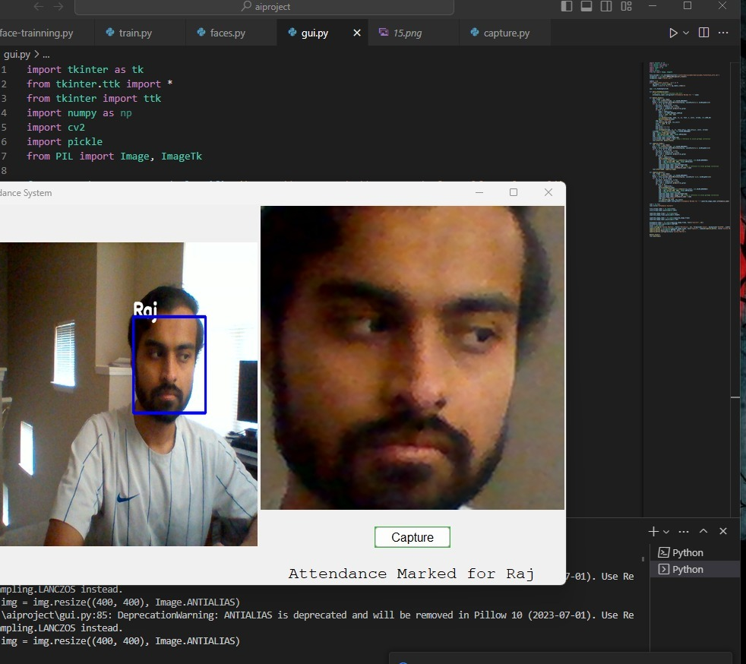
RESULTS
Successfully developed a biometric facial recognition system using the Haar-cascade algorithm and custom dataset training.
Achieved an accuracy rate of around 60-70% for facial recognition.
Identified limitations in the form of a limited number of images for each user and the need for a more powerful system and a standardized image background.
Opportunities for future improvements include increasing the number of images for each user, developing a more optimized model, and using a standardized image background.
The biometric facial recognition system has the potential to be a valuable tool in various applications, from security and surveillance to attendance tracking and access control.

Slide 12
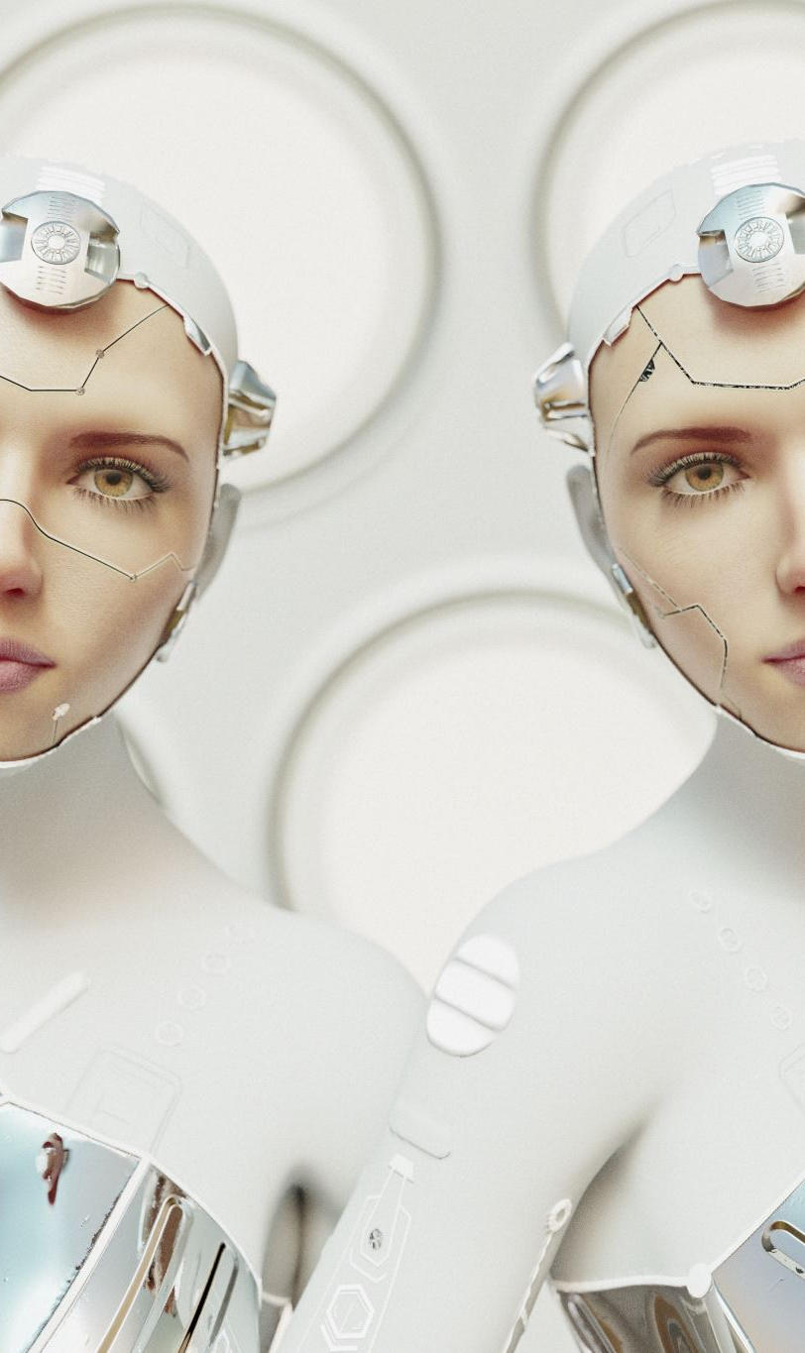
CONCLUSION
Our team has developed a biometric facial recognition system that accurately identifies individuals based on their facial features.
Various techniques, such as the Haar-cascade algorithm and custom dataset training, have been successfully implemented to achieve high accuracy.
Limitations of the system include the need for more images for each user and a more powerful system.
Despite these challenges, we remain committed to refining the system for even higher levels of accuracy and reliability.
The biometric facial recognition system has the potential to be a valuable tool in various applications, and we are excited about the possibilities for future developments in this field.
.

Slide 13
Thank you

